Slide 1
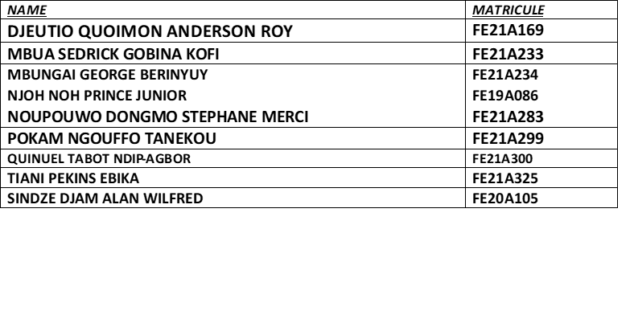
MOBILE COMMUNICATIONS AND PROCOLS [CEF 356]
PRESENTED BY:
COURSE INSTRUCTOR: DR VALERY

Slide 2
PROJECT 1: RADIO NETWORK PLANNING OF A 4G NETWORK
AIM:
HARDWARE AND SOFTWARE REQUIREMENTS:
Personal computer
Atoll and Google Earth
The objective of this section of the Mobile and Wireless Communications laboratory session is to
perform coverage planning of a newly deployed LTE network in Atoll, a radio network planning
software package.

Slide 3
PROCEDURE:
First and foremost, before the actual deployment of the BTS on the field we need to plan their position. This is done with the help of Geospatial Information Systems (GIS) like Google Earth. To do this Google earth is started on our PC with a working internet connection. This is done in this way so that we can have an updated layout of the terrain which we want to work with. When that is done, we should see a window like the one below :

Slide 4
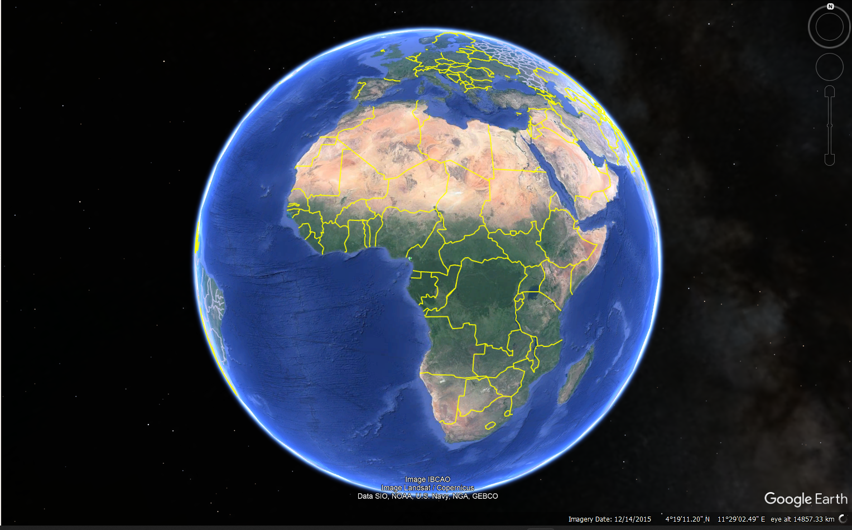
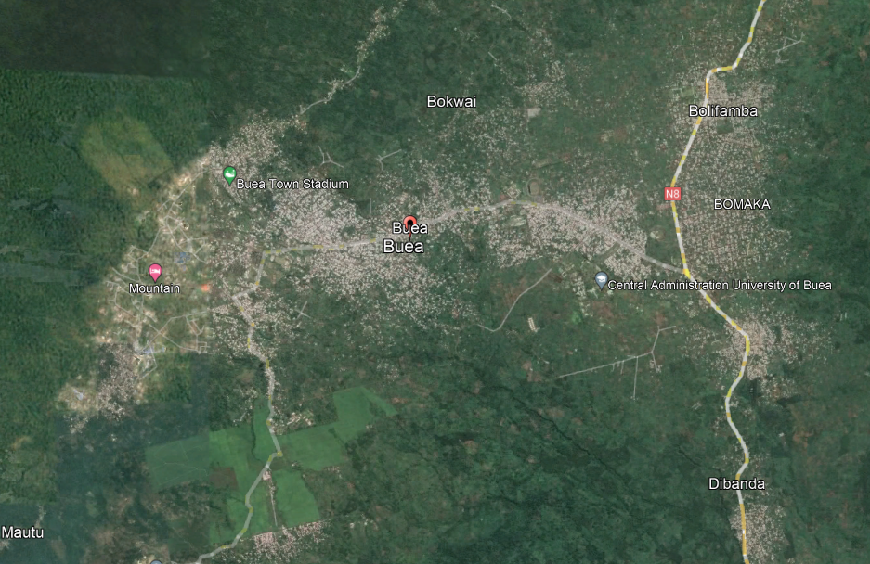
BUEA FROM GOOGLE EARTH
EARTH FROM GOOGLE EARTH

Slide 5
LAB 1: RADIO NETWORK PLANNING OF A 4G NETWORK
After we have correctly launched the atoll software and selected the correct time zones and coordinate systems for our project, we are ready to import our coordinates recorded on the excel sheet to our sites on Atoll.
For each of these sites which in practice represent the location of our BTS we will add 3 antennas, to utilize the concept of sectoring which will allow us to have a better coverage and signal quality. In this case, we will use 65deg 18dBi 4Tilt 2100MHz antennas.
The colours represent the signal level with respect to the BTS from which it is emitted, the red region being the area of greater intensity and the blue regions those of weak signal levels. The following chart represents the mapping of signal level (in Decibels) to the different colours.
After this done, we can export our prediction to our favourite GIS (in our case Google Earth). Hence we obtain the following image .

Slide 6
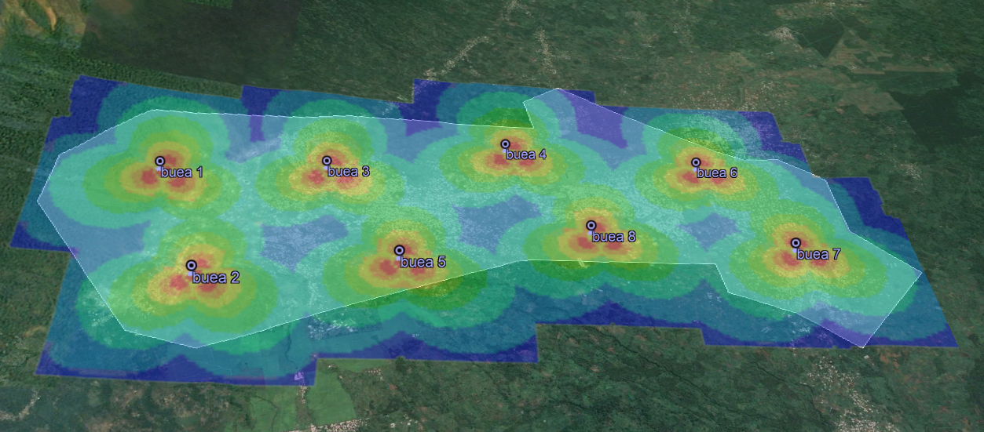
Diagram from google earth

Slide 7
OBSERVATION:
We notice from the from the prediction that to effectively give the optimal network coverage to all zones we will need to use more BTS which will also give permit us to have more subscribers. So, as the town grows and expands to actually uninhabited zones further planning will need to be done.
CONCLUSION:
This procedure produced a good layout plan for a radio network planning of a 4G network in the town of Buea and with more research and investigation more improvements could yield better results.

Slide 8
AIM
Configure a WLAN to connect FET Building and TECH Building

Slide 9
REASONING
For the distribution and placement of the APs, the following was decided:
An AP will be installed in each building to permit communication between the building
SPECIFICATIONS:
An AC: AC6005
Applicable Aps: AP2050
Switches: S5700
Stations: STAs etc.

Slide 10
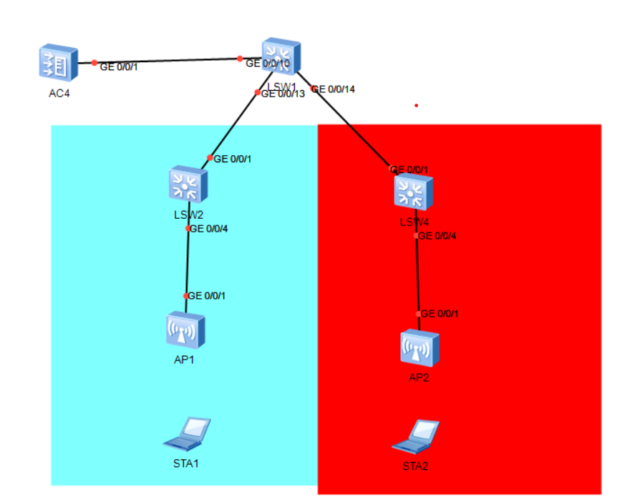
TOPOLOGY:
The AC is deployed in an out-of-path mode and is on the same layer 2 network as the Aps
The AC functions as a DHCP server to assign IP addresses to Aps and S1 functions as a DHCP server to assign IP addresses to stations

Slide 11
REQUIREMENT ANALYSIS
Two VLANS were implemented: VLAN 100 for the Aps and VLAN 101 for the Stations
All physical link will be trunk
The ip address : 192.168.100.254/24 is the ip address used by the Aps to communicate with the AC
The ip address 192.168.101.254 is used as the gateway for the stations
An ap-group named ap-group1 is created
Also, a regulatory profile with the name default and country code CN is created
An SSID profile with name HCIA-WLAN and SSID name HCIA-WLAN is created
A security profile with name HCIA-WLAN with security policy WPA-WPA2+PSK+AES and password HCIA-Datacom is created.
Finally a VAP profile which bounds all the profiles we have created with service VLAN 101 in the direct forwarding name

Slide 12
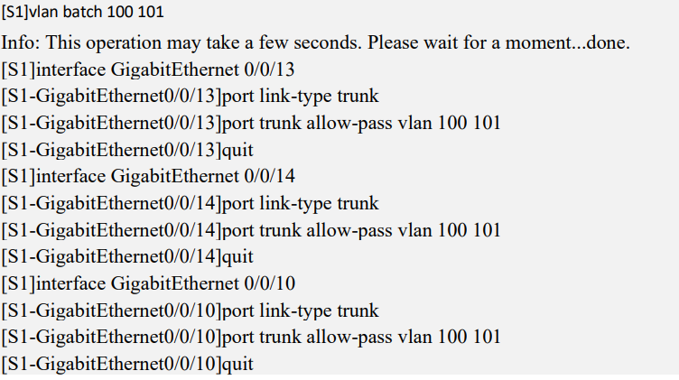
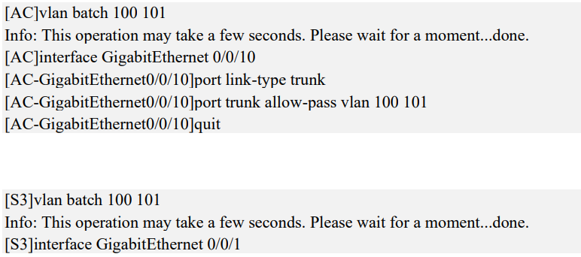
IMPLEMENTATION STEPS
Step 1: Name the devices using the command “syaname name_of_device” in the system view
Step 2: Configure the wired network.

Slide 13
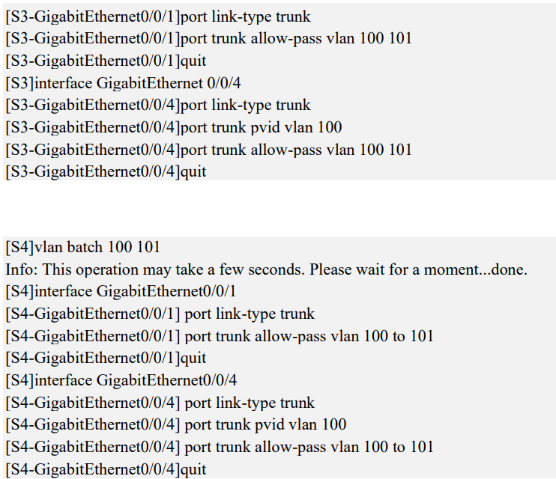
Here we configure each interface as trunk and allow vlan 100 and 101
Interface GE0/0/4 of S2 and S3 is configured with pvid of 100

Slide 14
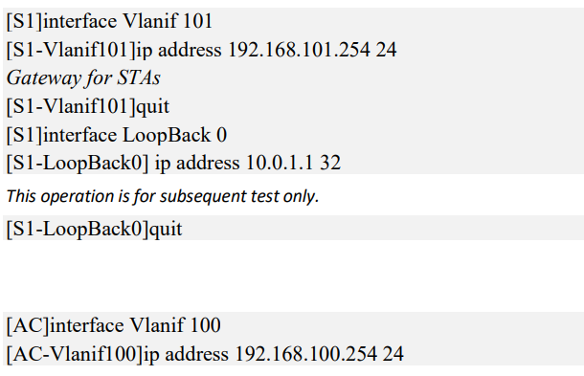
Configure interface IP addresses
Here we configure Vlan interfaces 101 on S1 and 100 on AC and assign ip address to the interfaces. The loopback interface is used to test if devices can connect to the internet

Slide 15
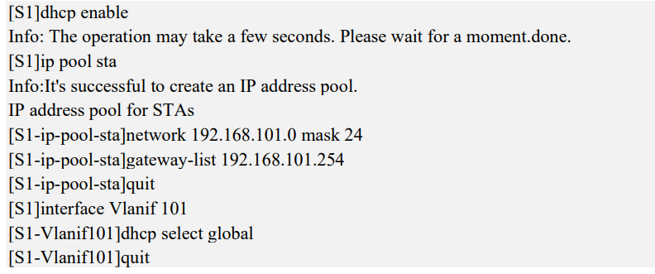
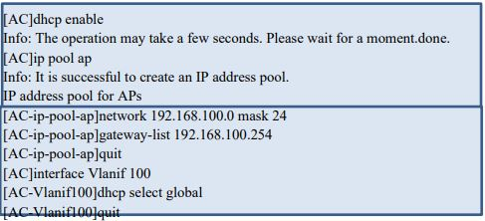
Configure DHCP
Configure S1 as DHCP for stations and name it ip pool sta then give it a network address and specify the gateway as the Vlanif that we just created and enable the vlan interface
Configure AC as DHCP for APs and name it “ip pool ap” then give it a network address and specify the gateway as the Vlanif that we just created and enable the vlan interface

Slide 16
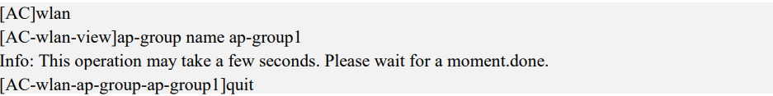
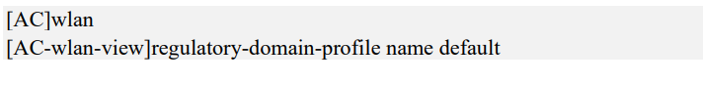
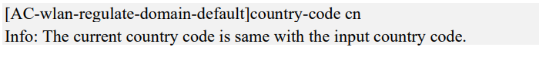
Step 3: Configure the APs to bring them online.
Create an AP group and name it ap-group1.
• Create a regulatory domain profile with the name: default, and set the AC country code in the profile as the default country code CN

Slide 17
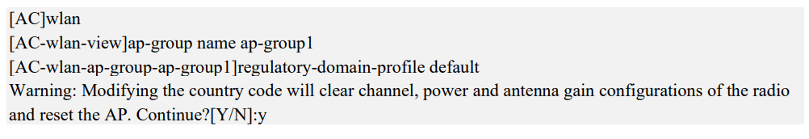
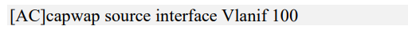
Bind the regulatory domain profile to the AP groups we just created.
Specify a source interface(address) on the AC for establishing CAPWAP tunnels.
Import Aps to the AC and add the Aps to AP group ap-group1 using manual configurations
but specifying the MAC address of the Aps and add the AP to the ap-group1(for both APs)

Slide 18
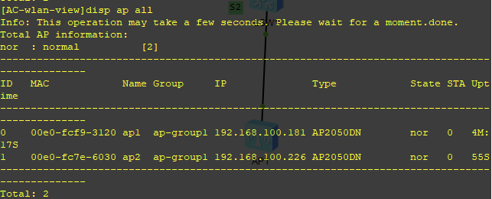
Display the information about the current AP(in the wlan view)

Slide 19

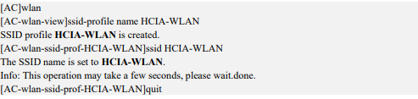
Step 4: Configure WLAN service parameters.
Wpa or wpa2 is used for authentication of terminals, a preshared key(HCIA-Datacom) is used and the encryption algorithm for user traffic is aes
AN SSID profile is created and the SSID name set to HCIA-WLAN.

Slide 20
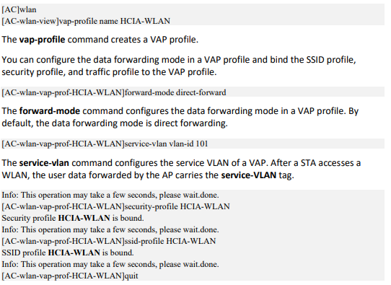
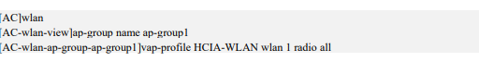
• A VAP profile HCIA-WLAN is created, a data forwarding mode is configured to direct-fowarding and service VLAN are configured with the vlan-id 101, and the security and SSID profiles are applied to the VAP profile.
• The VAP profile is bound to the AP groups and the configurations in VAP profile HCID-WLAN are applied to radio 0 and radio 1 of the Aps in the AP groups. All configurations of the AP group

Slide 21
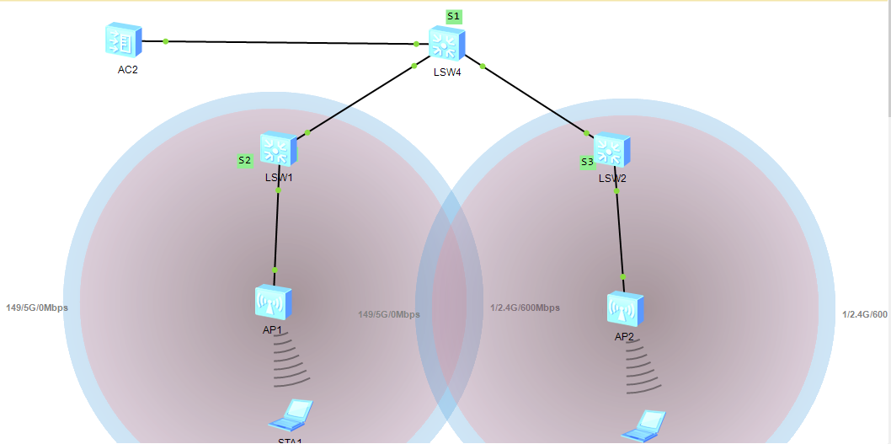
RESULT

Slide 22
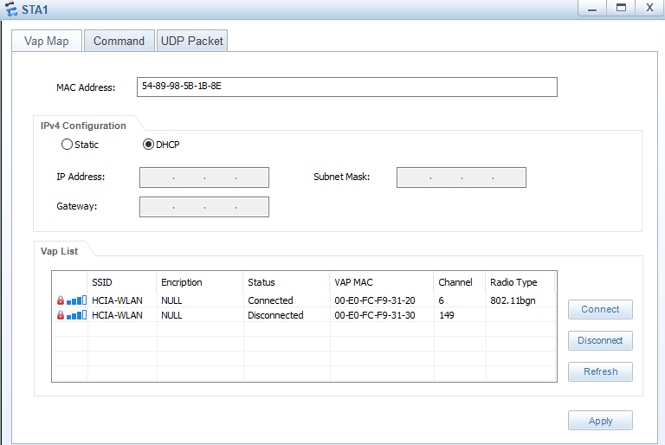
TESTING THE SYSTEM
The STAs were used to access the WLAN with the SSID of HCIA-WLAN.

Slide 23
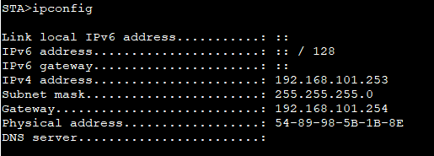
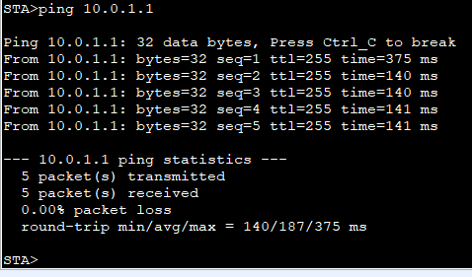
The ip address of the STA is checked
The STA is used to ping the loopback interface to determine if the devices can connect to the internet

Slide 24
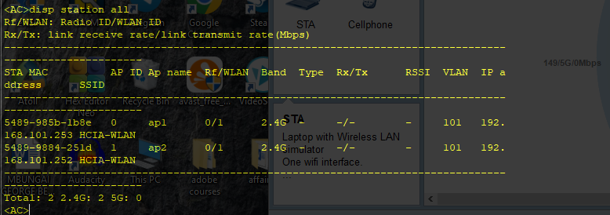
The devices connected are displayed from the AC

Slide 25
CONCLUSION
In a WLAN the end devices are able to connect wirelessly to the network. When coupled with a VLAN protocols we are able to separate these devices and restrict them to particular levels of access depending on our network requirements and constraints.
After the design and configuration of the WLAN, an access station can be installed at FET building and another at technological building so that devices in each location can connect to the access and share layer 2 frames. Devices in separate buildings can communicate passing through S1

